Slide 1
Segmentation and
RFM Basics
Bill Ruppert, ResponseB2B
wruppert@responseb2b.com
817-442-0698

Slide 2
Introduction
Who to mail?
How often to mail them?
Fundamental questions

Slide 3
Basic Tools
The Segment
RFM to define segments
Some simple reports

Slide 4
Segments
The mail / no mail decision is made at a group level
That group is called a segment
  Every name is mailed or not mailed
  Pros: simplicity, control, transparency
  Cons: defining, multiplication

Slide 5
Desirable Attributes
Similarity - within a segment
Distinctiveness - between segments
Comparability - over time
Size - large enough to have meaning

Slide 6
Similarity
The names within a segment have a similar behavior
Justifies mailing all or none

Slide 7
Distinctiveness
The segment behaves differently than other segments
Is there really a difference between a 6 time and 7 time buyer?

Slide 8
Comparability
Able to compare the results from a segment over time
Requires stability in the RFM definition process
In prospecting, requires thought in ordering lists

Slide 9
Size
The segment should be large enough that the results are statistically valid
Cell grouping, described later, helps with this

Slide 10
Prospecting Segments
A Prospecting segment is a particular select from a list
  12 month buyers
  SIC 35xx with 1-4 employees
Prospecting lists are often small

Slide 11
House File Segments
RFM = Recency, Frequency, Monetary
Easy to implement
Easy to understand
More then adequate for most B2B direct marketers

Slide 12
RFM Values vs. Cells
The RFM values are the actual unique value for each customer
  138 days; 17 orders; $1,465.27
The RFM cells are groupings of values
First, define how values are calculated
Second, define how the cell are defined

Slide 13
Recency Value
The date of last order
The most powerful predictor of who is likely to order
Notes:
The customers who ordered last month are more likely to respond to a mailing then the ones who last ordered two months ago.
And so on…
This simple fact is the “central dogma” of direct marketing.

Slide 14
Frequency Value
Frequency is the next most powerful predictor of response
Do not use the total count of lifetime orders as the definition of frequency
Pick a time limit back from the most recent order
Notes:
Lifetime orders can be misleading for it gives too great of a weight to far past activity.
This very old activity is not a good indicator of current responsiveness.
A better definition of frequency is the number of orders placed within a set period of time from the most recent order.
If this time period is set very long (not recommended), the effect is essentially the same as using lifetime orders.
We can favor very active customers if the period is short (say 12-18 months).
Three years is a good default value.

Slide 15
Monetary Value
Monetary is the least powerful
Especially useful to avoid mailing very low value customers
Total sales directly correlated to order frequency
Use the average order size of the orders counted for frequency
Notes:
Monetary value can be used to further segment a recency/frequency group, although its effect is not as strong as the other two factors.
A good use for monetary value is to avoid mailing very low value customers.
I define monetary value as the average size of the orders counted for frequency.
Using total sales causes monetary to be strongly correlated to frequency rendering it useless.
Using average order size removes that relationship and makes it an independent variable.

Slide 16
Defining RFM Cells
Compute the values as defined above
Define a cell structure - ranges of values for R, F and M
Assign each customer to a cell
Use cells for reporting, analysis, mailing decisions, etc.

Slide 17
Number of Cells
The number of cells you create is important
Too few cells reduces the discriminatory power of your segmentation
Too many cells is hard (or even impossible!) to work with

Slide 18
A Starting RFM Cell Structure
A place to start from, but everyone has different needs
108 cells for the first three years of buyers and nine cells for every year after that

Slide 19
Recency
Quarters for 3 years
  0-3 mo, 4-6 mo, 9-12 mo, …., 34-36 mo
  Some may need more in the first year
  Others may need less after the first year
Year groups after that
  37-48 mo, 49-60 mo, ...

Slide 20
Frequency
A simple 1, 2, 3+ for frequency
Recent, 1x buyers are new customers - special treatment
If really aggressive, you may want higher frequency cells for mailing more often

Slide 21
Monetary
Start with 3 groups based on ranges of average order size
Low - less then one half AOS
Normal - one half to twice AOS
High - over twice AOS
May need a special “Very Low” for reduced mailings

Slide 22
RFM Cell Groups
Sometimes you need many RFM cells
  if short R periods are needed
  if both higher F and higher M values have strong predictive power
The number of cells can multiply quickly
Solution - RFM Cell Groups

Slide 23
Group Similar Mailing Patterns
Define groups of cells sharing a default mailing pattern
The default decisions can be changed at the cell level as needed

Slide 24
The A's, B’s and C’s
“A” - the best cells, mailed every time
“B”, “C”, “D” - good to not so good
“N” - current new buyers
  “over-mail” in an attempt to convert into multi-buyers
“X” - so bad, you’ll never mail
  slug and test as though a prospecting list

Slide 25
Segmentation Enhancements
Product History
  RFM report by Product Groups
SIC and Employee Size
  RFM report by SIC / Employee Size Groups
Create special RFM Cells
  fewer cells
Notes:
The buyers of different types of products act very differently from each other.
If you sell several distinctive product lines in one catalog, you should look at RFM and retention reports for the different product buyers.
If you see greatly different behavior, you may want to construct different mail plans for each type of buyer, including specialized catalogs.
For customers, RFM and product history far outweigh SIC / employee size.
For prospecting, SIC and employee size are very valuable since they are one of the few facts consistently available.
You have to understand your existing customers in order to gain new ones.
You may not use the information for house mailing decisions, but it is critical for prospecting.

Slide 26
Example Reports
Forecasting and Sales Reporting
Using RFM Cell Groups
RFM Dynamics

Slide 27
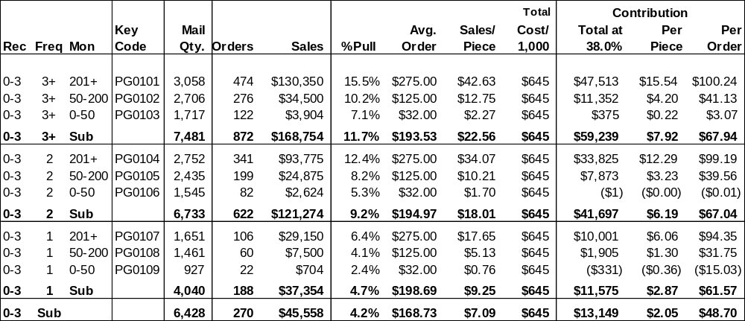
Forecasting and Sales Reporting

Slide 28
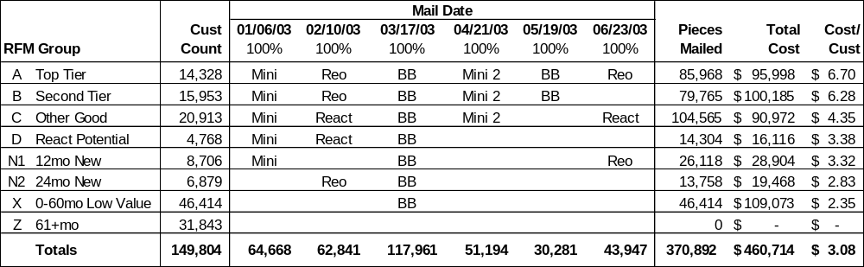
Using RFM Cell Groups

Slide 29
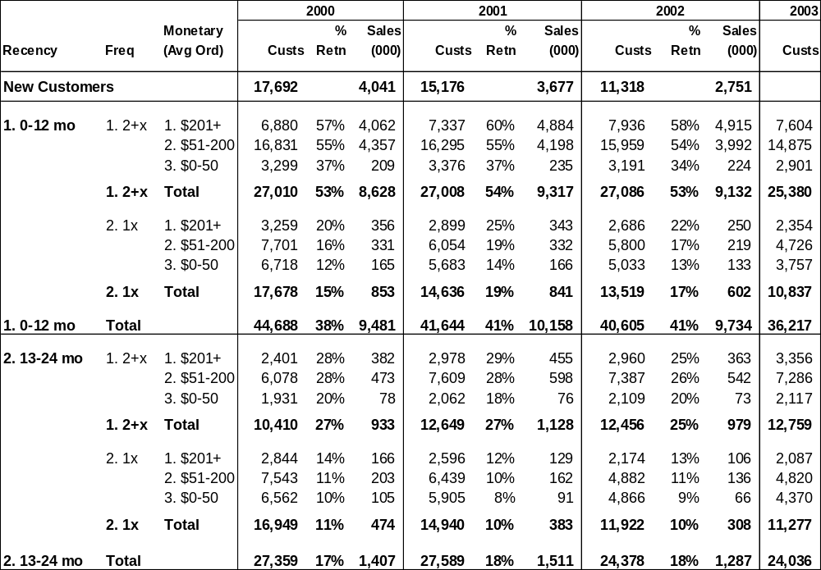
RFM Dynamics

Slide 30
Thank You!
Thank you for your kind attention!
And thanks to MeritDirect for inviting me!

